Slide 1

Decision Tree Modeling

Slide 2
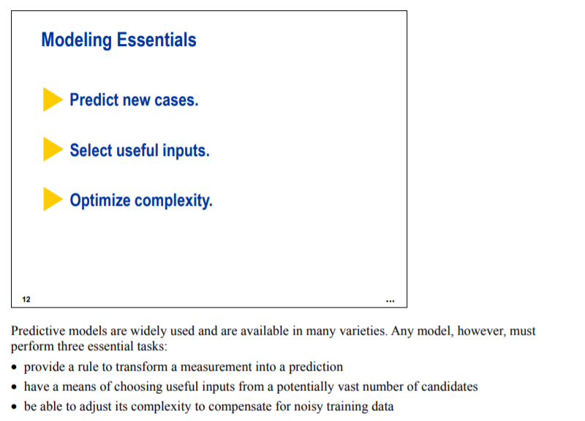
Decision Tree Modeling

Slide 3
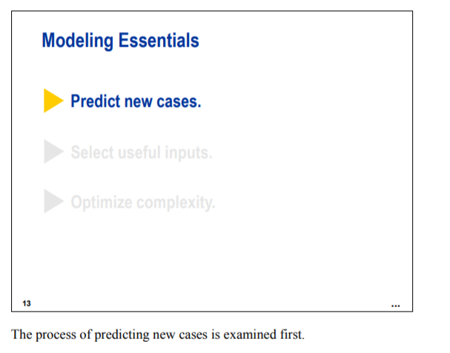
Decision Tree Modeling

Slide 4
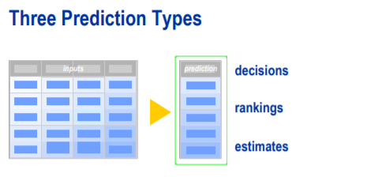
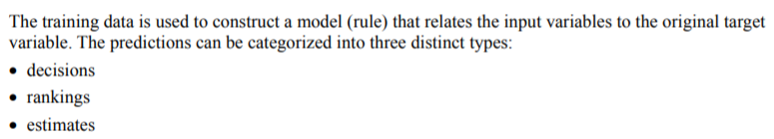
Decision Tree Modeling

Slide 5
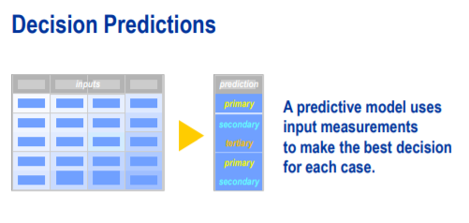
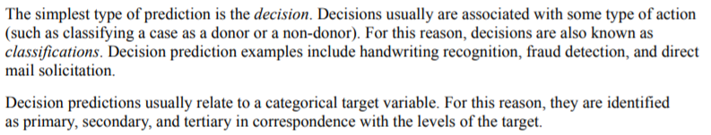
Decision Tree Modeling

Slide 6
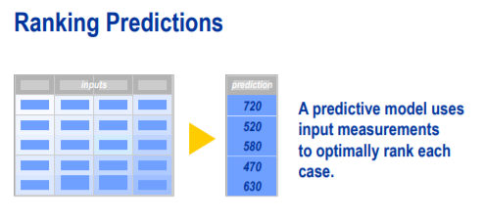
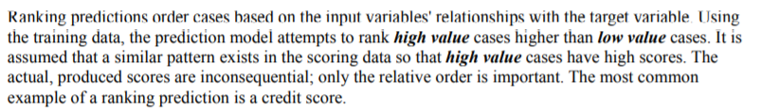
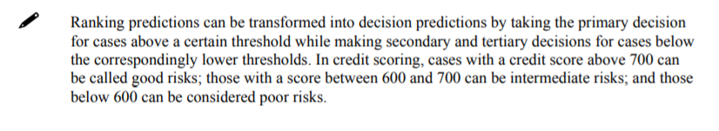
Decision Tree Modeling

Slide 7
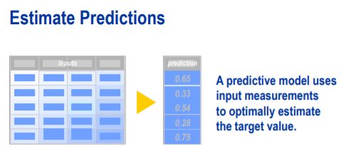
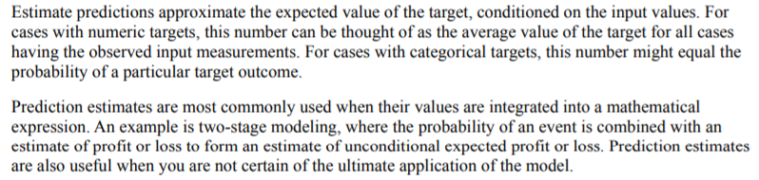
Decision Tree Modeling

Slide 8
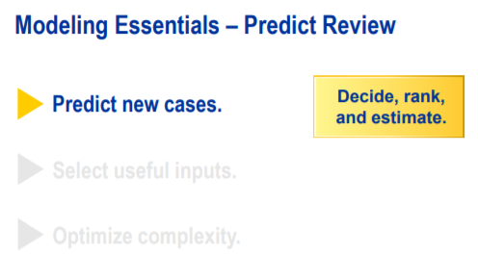
Decision Tree Modeling

Slide 9
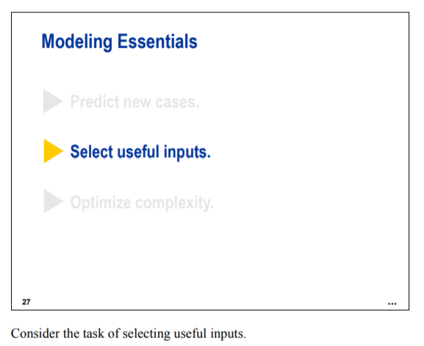
Decision Tree Modeling

Slide 10
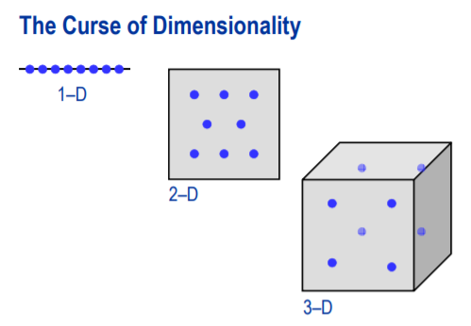
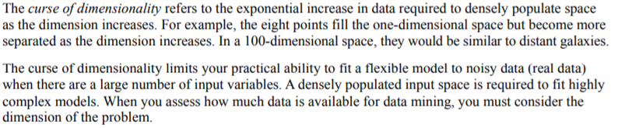
Decision Tree Modeling

Slide 11
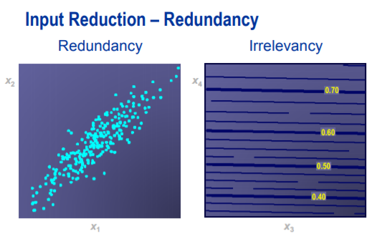
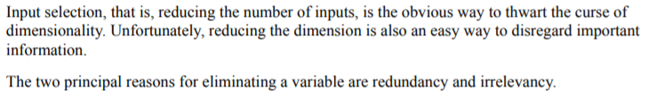
Decision Tree Modeling

Slide 12
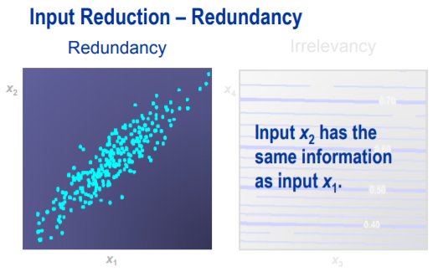
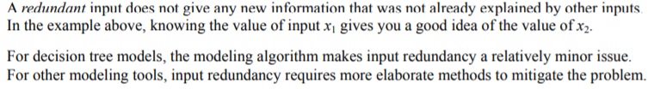
Decision Tree Modeling

Slide 13
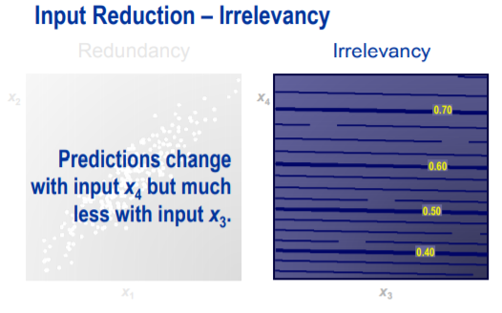
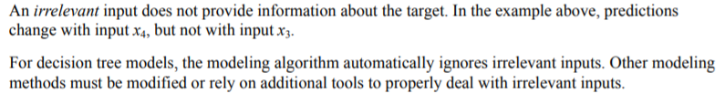
Decision Tree Modeling

Slide 14
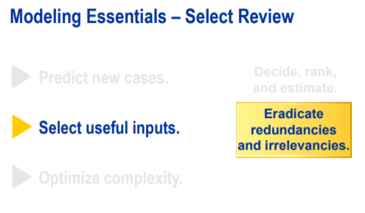
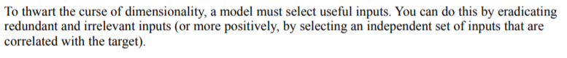
Decision Tree Modeling

Slide 15
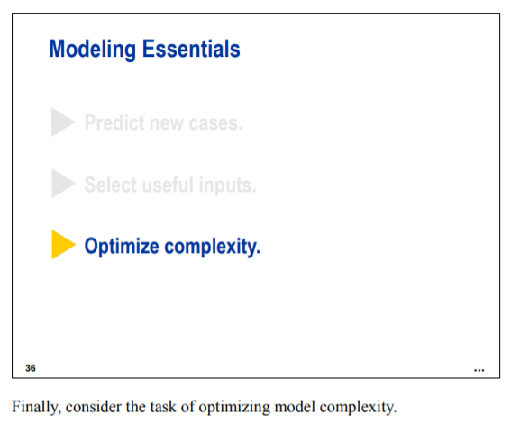
Decision Tree Modeling

Slide 16
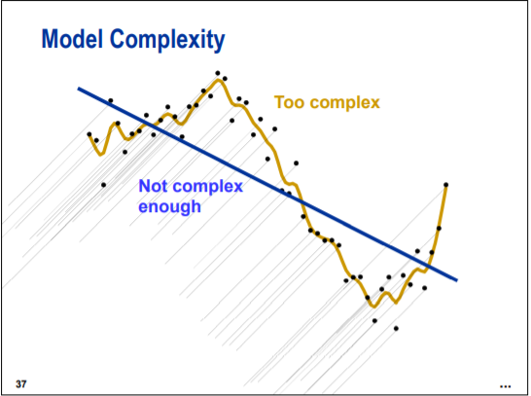
Decision Tree Modeling

Slide 17
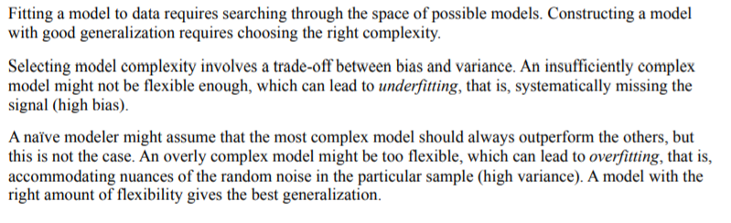
Decision Tree Modeling

Slide 18
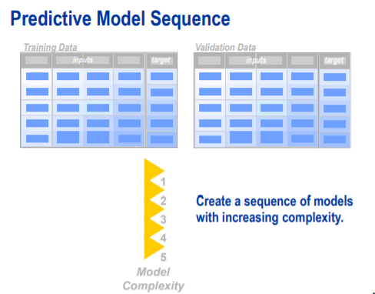
Decision Tree Modeling

Slide 19
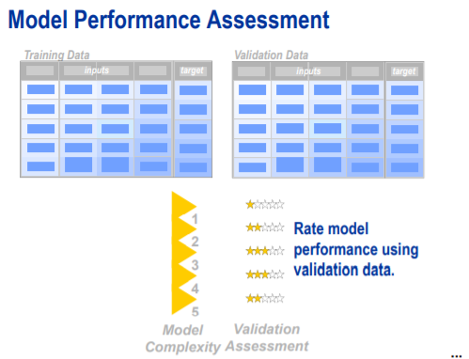
Decision Tree Modeling

Slide 20
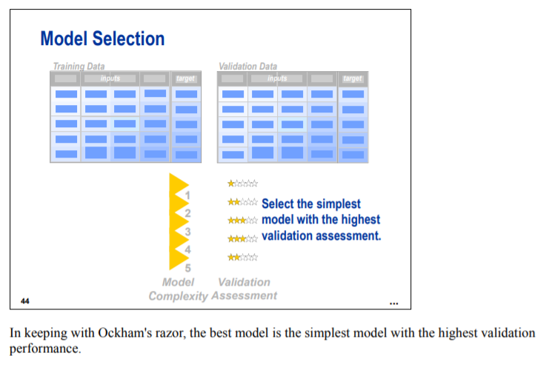
Decision Tree Modeling

Slide 21
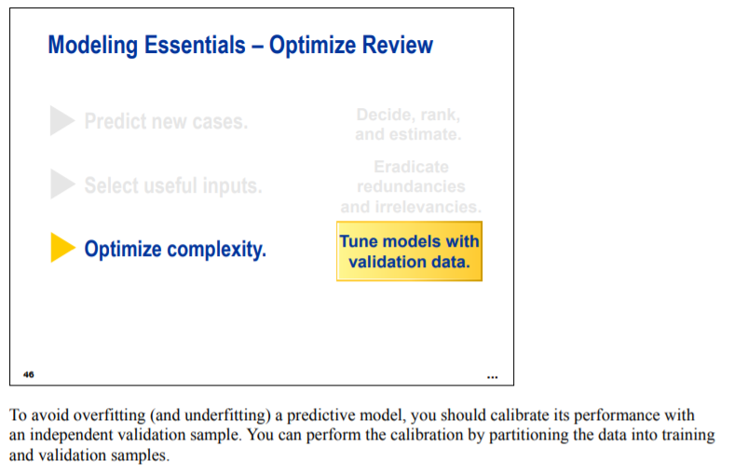
Decision Tree Modeling

Slide 22
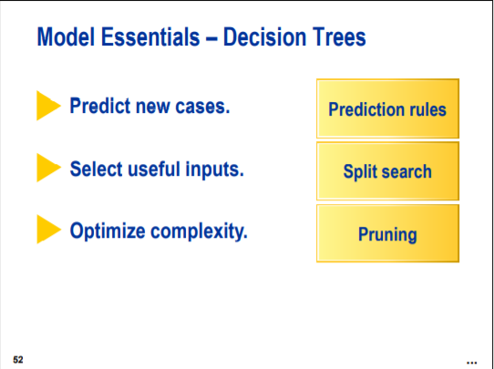
Decision Tree Modeling

Slide 23
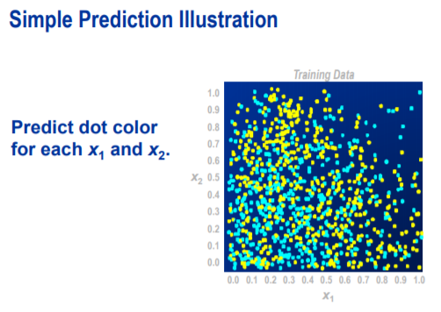
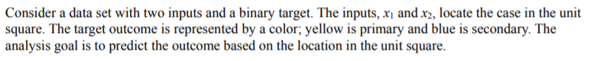
Decision Tree Modeling

Slide 24
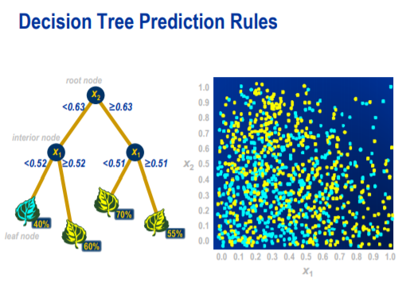
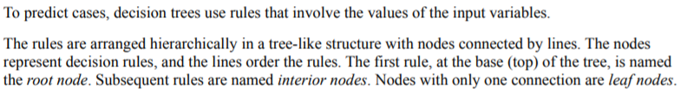
Decision Tree Modeling

Slide 25
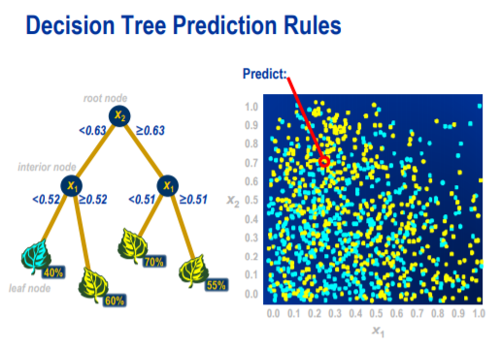
Decision Tree Modeling

Slide 26
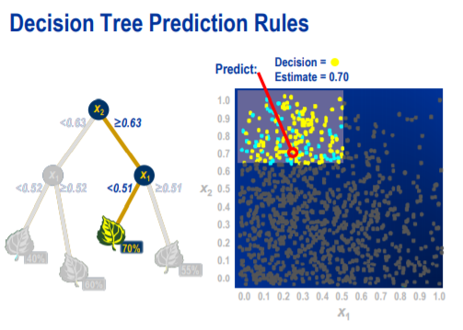
Decision Tree Modeling

Slide 27
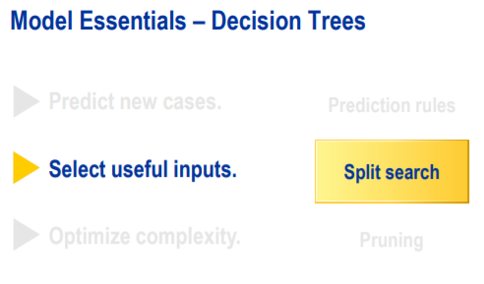
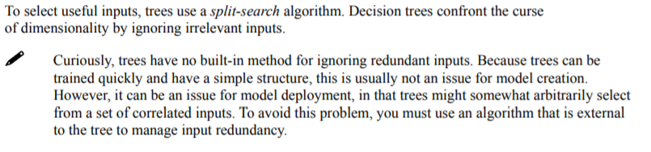
Decision Tree Modeling

Slide 28
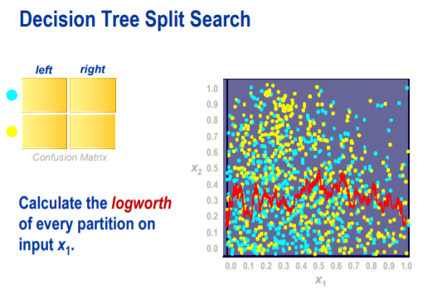
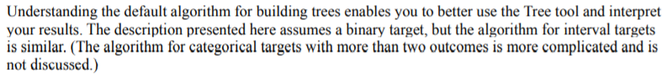
Decision Tree Modeling

Slide 29
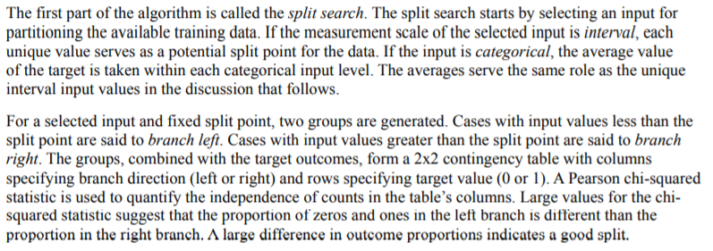
Decision Tree Modeling

Slide 30
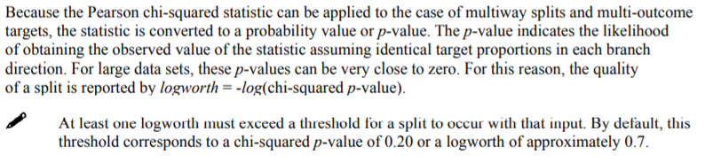
Decision Tree Modeling

Slide 31
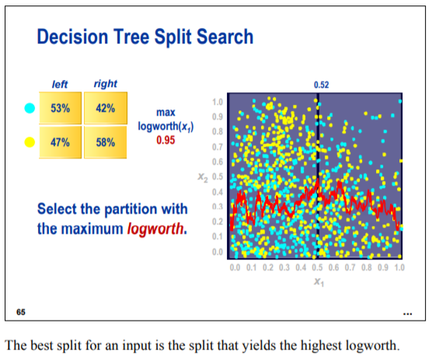
Decision Tree Modeling

Slide 32
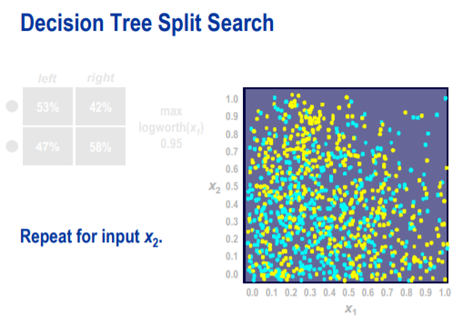
Decision Tree Modeling

Slide 33
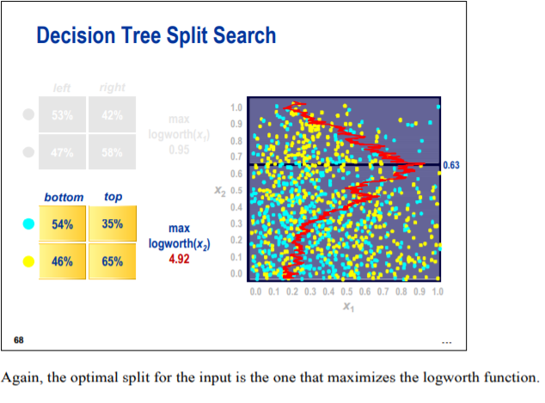
Decision Tree Modeling

Slide 34
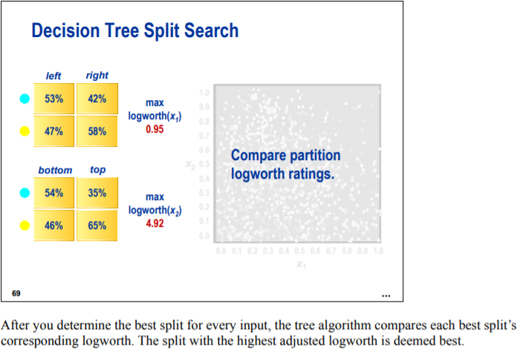
Decision Tree Modeling

Slide 35
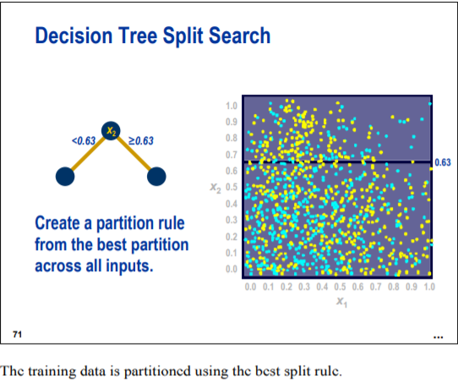
Decision Tree Modeling

Slide 36
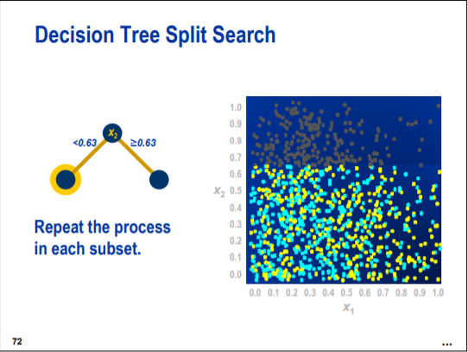
Decision Tree Modeling

Slide 37
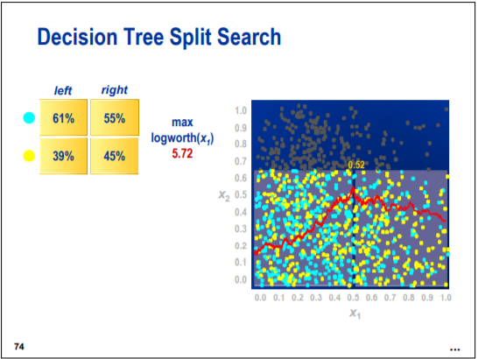
Decision Tree Modeling

Slide 38

Decision Tree Modeling

Slide 39

Decision Tree Modeling

Slide 40

Decision Tree Modeling

Slide 41

Decision Tree Modeling

Slide 42

Decision Tree Modeling

Slide 43

Decision Tree Modeling

Slide 44

Decision Tree Modeling

Slide 45


Decision Tree Modeling

Slide 46

Decision Tree Modeling

Slide 47

Decision Tree Modeling

Slide 48

Decision Tree Modeling

Slide 49

Decision Tree Modeling

Slide 50

Decision Tree Modeling

Slide 51

Decision Tree Modeling

Slide 52

Decision Tree Modeling

Slide 53

Decision Tree Modeling

Slide 54

Decision Tree Modeling

Slide 55

Decision Tree Modeling

Slide 56

Decision Tree Modeling

Slide 57

Decision Tree Modeling

Slide 58

Decision Tree Modeling

Slide 59

Decision Tree Modeling

Slide 60

Decision Tree Modeling

Slide 61

Decision Tree Modeling

Slide 62
DEMO

Slide 63
Q&A

